Slide 1
REVIEW OF CHAPTER 2
Statement: sentence/utterance that can be viewed as either true or false
Non-statements:
Questions
Greetings
Commands
Requests
Proposals
Instructions
Exclamations
Non-arguments:
Reports
Unsupported assertions
Conditional sentences
Illustrations
Explanations
Statements: core of an argument
Argument: premise(s) + conclusion(s)
Argument: core of critical thinking
* Assumption: hidden belief/principle that that decides the value of the conclusion

Slide 2
CHAPTER 2 - ASSIGNMENT

Slide 3
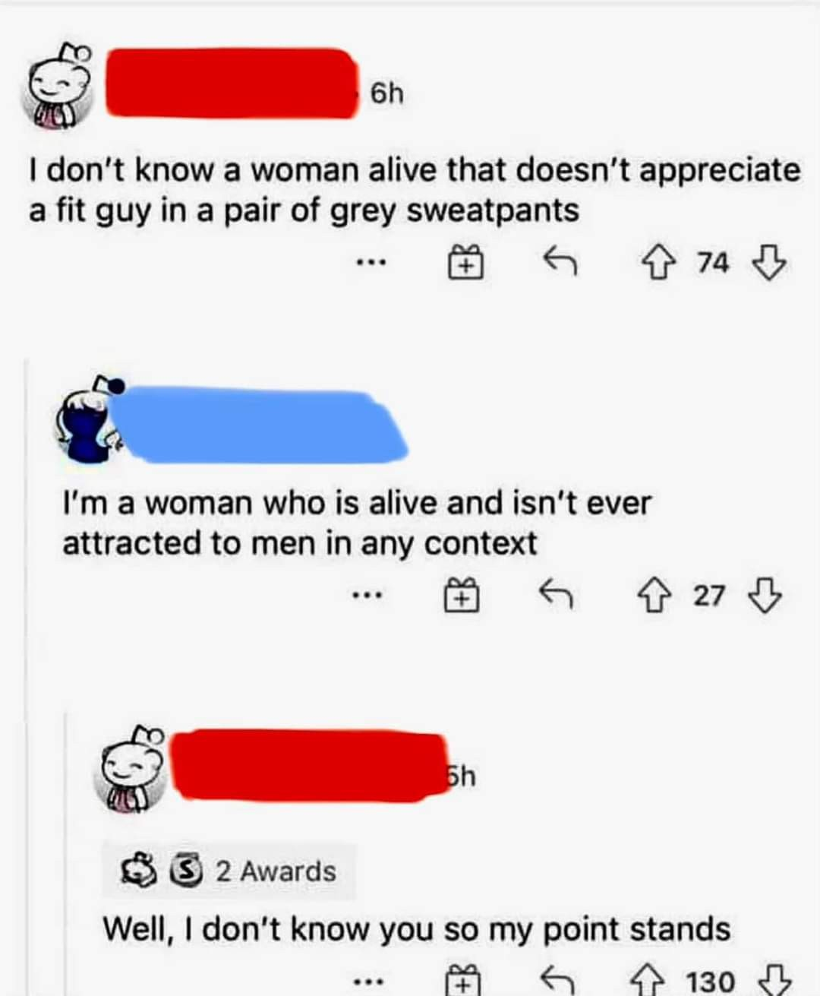
Task 1: Identify each text. If there is an argument, find the premise, conclusion and assumption
Answer:
Sentence 1: Not an argument (unsupported assertion)
Sentence 2:
- Premise: “I’m a woman who is alive isn’t ever attracted to men in any context”
- Conclusion: the man is wrong (which is implied)
- Assumption: The woman assumed that the “don’t know” of the man is objective, which means every woman aliving in the world appreciate a fit guy in a pair of grey sweatpants.
Sentence 3:
- Premise: “I don’t know you”
- Conclusion: “My points stands”
- Assumption: The man assumed that his statement is subjective. The “don’t know” here covers only the women that he meets and knows
Notes:
Nguyen Minh An - BEBEIU22185
2. Vu Cao Bang - BEBEIU22014
3. Tran Thi Ngoc Diep - BEBEIU22183
4. Nguyen Do Quoc Hai - BEBEIU22032
5. Ngo Minh Khoi - BEBEIU22063
6. Nguyen Quoc Trung Nhan - BEBEIU22184
7. Vo Duc Trong - BEBEIU22155
8. Lam Hoang Xuan Yen - BEBEIU22272

Slide 4
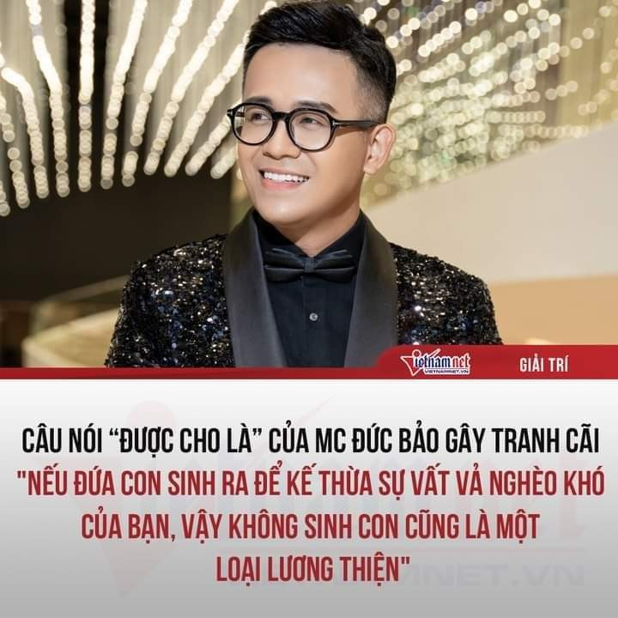
Task 2: Is the speaker’s text an argument? If not, rewrite it in the form of an argument.
Answer:
- The speaker’s text is not an argument. This is a conditional sentence.
Rewrite: Đứa con sinh ra để kế thừa sự vất vả nghèo khó của bạn, vậy không sinh con cũng là một loại lương thiện.
(Your child may be born to inherit your hardship and poverty. So not having children is also an act of kindness.)

Slide 5
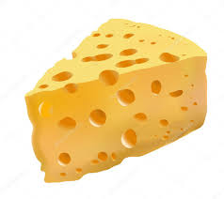
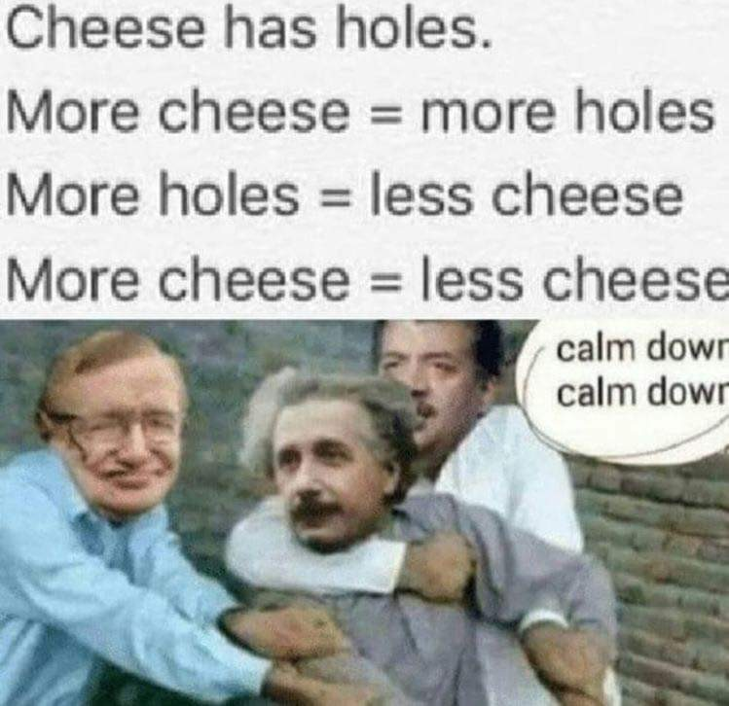
Task 3: Indicate the premises and the conclusion. Then identify the assumption to agree or disagree with the conclusion.
Answer:
- Premise 1: Cheese has holds
- Premise 2: More cheese = more holes
- Premise 3: More holes = less cheese
- Conclusion: More cheese = less cheese
- Assumption: “More cheese” is considered into two distinct aspects. The second statement focuses on the changing quantity of cheese, while the third statement focuses on cheese per fixed quantity.
=> These two statements contradict each other.
=> Disagree with conclusion

Slide 6
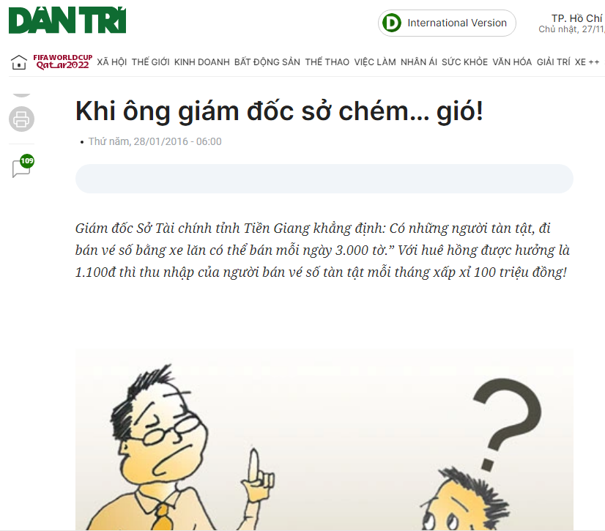
Task 4: Rephrase the Director’s argument’s argument and identify his assumption.
Rephrase: According to the director, since each ticket sells for 1100 VND commission and 3,000 tickets are sold every day, the profit made by those with disabilities from lottery sales might reach up to 100 million VND.
The fact: One lottery ticket might yield a commission of 1100 VND.
Opinion: It is possible for disabled people to sell 3,000 lottery tickets in one day.
Conclusion: People with disabilities using wheelchairs can earn 100 million each month.
=> Assumption: The condition is that people are disabled, sell lottery tickets each day of the month and sell 3000 tickets in one day.
Notes:
Nguyễn Ngọc Mỹ Phương -BEBEIU22114
2. Phạm Thái Nhật Thanh-BEBEIU22133
3. Nguyễn Thị Như Quỳnh-BEBEIU22122
4. Đặng Thị Trúc Thắm - BEBEIU22132
5. Đặng Trần Minh Châu - BEBEIU22019
6. Nguyễn Ngọc Phương Thảo - BEBEIU22135
7. Lê Đức Toản - EEEEIU22065
8. Đỗ Minh Duy - ITITSB22029

Slide 7
Task 4: Rephrase the Director’s argument’s argument and identify his assumption.
Modified
Premise 1: One sold lottery ticket gives a commission of 1100 VND.
Premise 2: Some disabled people can sell 3,000 lottery tickets one day.
Conclusion: People with disabilities can earn 100 million each month.
=> Assumption: Disabled people can constantly sell 3,000 lottery tickets 30 days of the month.
Notes:
Nguyễn Ngọc Mỹ Phương -BEBEIU22114
2. Phạm Thái Nhật Thanh-BEBEIU22133
3. Nguyễn Thị Như Quỳnh-BEBEIU22122
4. Đặng Thị Trúc Thắm - BEBEIU22132
5. Đặng Trần Minh Châu - BEBEIU22019
6. Nguyễn Ngọc Phương Thảo - BEBEIU22135
7. Lê Đức Toản - EEEEIU22065
8. Đỗ Minh Duy - ITITSB22029

Slide 8
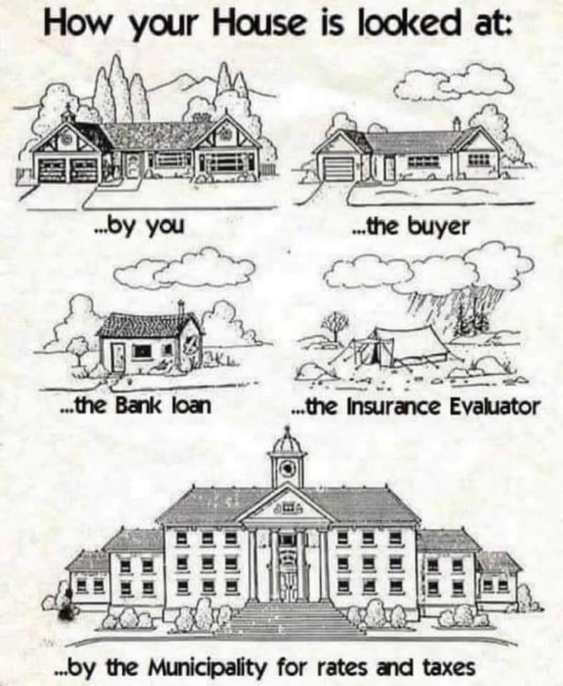
Task 5: Make an argument out of the meme.
Argument: Different people have different ways of evaluating a house. In the end, a home's true value depends on personal viewpoints, going beyond its physical aspects and reflecting individual priorities.
- Premise 1: There exists a house that is being evaluated by different people.
- Premise 2: These people have different priorities when evaluating the house.
- Conclusion: In the end, a home's true value depends on personal viewpoints, going beyond its physical aspects and reflecting individual priorities.
Notes:
Phan Tấn Phong - BAFNIU21535 2. Trương Thị Vân Anh - ENENIU22143 3. Nguyễn Ngọc Anh Thư - ENENIU22154 4. Nguyễn Tấn Dũng - ITITIU21185 5. Lê Nguyễn Gia Anh - ENENIU22140 6. Nguyễn Lê Ngọc Minh - ENENWE22344 7. Lê Anh Thy - ENENWE21409 8. Dương Minh Nguyệt - ENENIU22101

Slide 9
Task 5: Make an argument out of the meme. Suggestion
Argument: Different evaluators see different values of the same house. So, a house’s value is not its true value.
- Premise: Five evaluators see five different values of the same house.
Conclusion: So, a house’s value is not its true value.
Assumption: Property value goes beyond its physical aspects and reflects evaluators’ priorities.
Notes:
Phan Tấn Phong - BAFNIU21535 2. Trương Thị Vân Anh - ENENIU22143 3. Nguyễn Ngọc Anh Thư - ENENIU22154 4. Nguyễn Tấn Dũng - ITITIU21185 5. Lê Nguyễn Gia Anh - ENENIU22140 6. Nguyễn Lê Ngọc Minh - ENENWE22344 7. Lê Anh Thy - ENENWE21409 8. Dương Minh Nguyệt - ENENIU22101

Slide 10
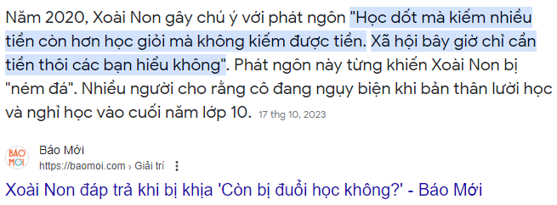
Task 6: Provide your meme and make an argument. Identify the premise(s), conclusion, and asumption(s).
Answer:
The highlighted text is unsupported asserions.
Source: Thức B. K. (2023, October 17). Xoài Non đáp trả khi bị khịa “Còn bị đuổi học không?” https://baomoi.com. Retrieved from https://baomoi.com
Notes:
Nguyen Minh An - BEBEIU22185
2. Vu Cao Bang - BEBEIU22014
3. Tran Thi Ngoc Diep - BEBEIU22183
4. Nguyen Do Quoc Hai - BEBEIU22032
5. Ngo Minh Khoi - BEBEIU22063
6. Nguyen Quoc Trung Nhan - BEBEIU22184
7. Vo Duc Trong - BEBEIU22155
8. Lam Hoang Xuan Yen - BEBEIU22272

Slide 11
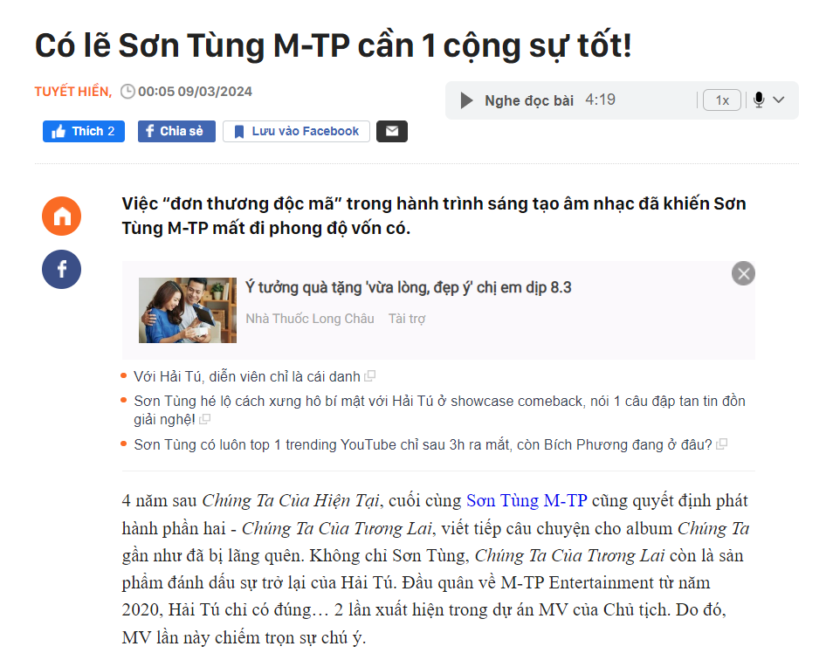
Task 6: Provide your meme and make an argument. Identify the premise(s), conclusion, and asumption(s).
Premise: Son Tung has just released his new song “Chung ta cua tuong lai” and maybe, he needs to find another ekip.
Conclusion: Son Tung should look for more creative companions.
Assumption: Due to his old-fashioned style of music, it is necessary for him to change his ekip
Notes:
Dương Thuỵ Hồng Ân - BEBEIU22274
Đặng Thị Tuyết Như - BABAIU22277
Nguyễn Văn Kiên - BABAWE22214
Đặng Khánh Huyền - MAMAIU22066
Nguyễn Hoàng Nam Phương - BABAWE22409
Huỳnh Quốc Bảo - MAMAIU22082
Trần Ngọc Anh Thơ - MAMAIU22074
Nguyễn Thị Kim Phụng - BABAWE22355

Slide 12
Task 6: Provide your meme and make an argument. Identify the premise(s), conclusion, and asumption(s).
Suggestion
Premise: Son Tung has been alone in his journey of music production, leading to his lost attraction.
Conclusion: Therefore, Son Tung probably needs a new companion.
Assumption: Teamwork makes dreamwork.
Notes:
Dương Thuỵ Hồng Ân - BEBEIU22274
Đặng Thị Tuyết Như - BABAIU22277
Nguyễn Văn Kiên - BABAWE22214
Đặng Khánh Huyền - MAMAIU22066
Nguyễn Hoàng Nam Phương - BABAWE22409
Huỳnh Quốc Bảo - MAMAIU22082
Trần Ngọc Anh Thơ - MAMAIU22074
Nguyễn Thị Kim Phụng - BABAWE22355

Slide 13
Lesson 3
BASIC LOGICAL CONCEPTS
13

Slide 14
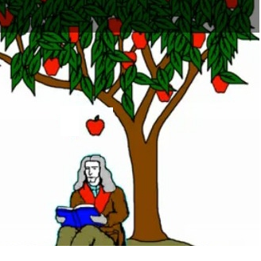
What will happen?
Observe and answer

Slide 15
Observe and answer
Which picture in the 2nd row continues the first row?

Slide 16
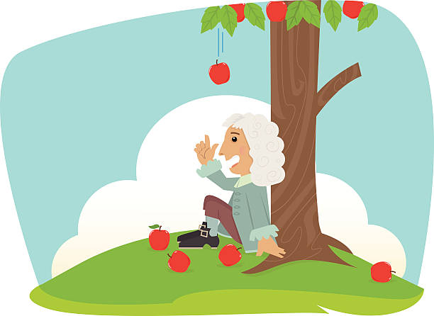
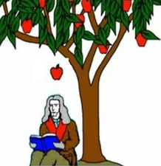
Two patterns of reasoning
Inductive argument
Deductive argument
Generalization
(theory)
General premise
Conclusion
(hypothesis)
Specific premise
Pattern
Conclusion
Premise
(observation)
Premise
(observation)
Premise
(observation)

Slide 17
Two basic categories of human reasoning
Deduction: reasoning from general premises, which are known or presumed to be known, to more specific, certain conclusions (formal reasoning)
Induction: reasoning from specific cases to more general, but uncertain, conclusions (informal reasoning)
Notes:
Every day, we make hundreds of arguments though we may not recognize that. No matter how many arguments we make, they fall into only two categories – deductive reasoning or inductive reasoning.
Deductive reasoning (Tư duy diễn dịch): The arguer bases his/her conclusion on general premises, normally these premises are well known or well recognized by the public. In other words, a deductive argument goes from general (premises) to specific (conclusion).
Inductive reasoning: (Tư duy quy nạp): The arguer generalizes his/her conclusion from specific premises (his/her own observations/facts, etc). As a result, an inductive argument is not so certain.

Slide 18
Examples of deductive and inductive reasoning
Today, some late students in our class said they had to move from the Central Library to IU main campus.
Probably all students were late today because of the campus change.
INDUCTIVE REASONING
IELTS 5.5 or equivalents are the requirement to begin the major’s courses at HCM-IU.
I recently sat for the IELTS exam and got 6.0.
Therefore, I am qualified for my major’s courses now.
DEDUCTIVE REASONING
Notes:
From ‘some students in our class’ to ‘all students’: specific to general
From the requirement for all students to my case: general to specific

Slide 19
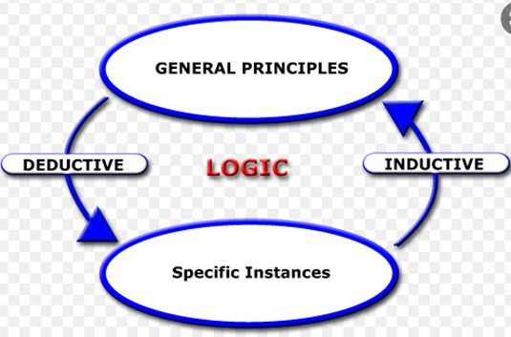
Deductive vs. Inductive reasoning

Slide 20
Deductive or inductive?
Task: Reorder the statements and decide if it is deductive or inductive.
A safe in the bank was unlocked last night.
Only two people know the safe’s combination lock: Cheaty and Fraudy.
Fraudy was also seen sneaking around outside the bank last night.
Fraudy once said he needed money to pay his gambling debts.
It is reasonable to conclude, therefore, that Fraudy broke in the bank and unlocked the safe.
Whoever opens the safe knows the safe’s combination lock.
Cheaty is now on business abroad.
Reordered argument: 1, 6, 2, 7, 4, 3, 5
→ Deductive argument
Notes:
Elimination: General to specific
(1) is actually not a premise; it’s just the background information.

Slide 21
Deductive or inductive?
In real life, arguments are not always in standard forms, which means certain premise(s) may be missing or inclusive.
Example:
Lincoln was President from 1861 to 1865.
So, all persons born during Lincoln’s presidency were born in the 19th century.
Standard deductive argument:
The 19th century is from 1801-1900. (missing general premise)
Lincoln was President from 1861 to 1865. (minor premise)
So, all persons born during Lincoln’s presidency were born in the 19th century.
(conclusion)

Slide 22
Deductive or inductive?
In real life, arguments are not always in standard forms, which means certain premise(s) may be missing or inclusive.
Example:
All of Stephen King’s previous novels have been good. Therefore, Stephen King’s next novel will probably be good.
* ‘All of Stephen King’s previous novels have been good.’ (generalized premise) includes several particular premises:
Stephen King’s first novel was good. (specific premise)
Stephen King’s second novel was good. (specific premise)
Stephen King’s most recent novel was good. (specific premise)
→ Inductive argument

Slide 23
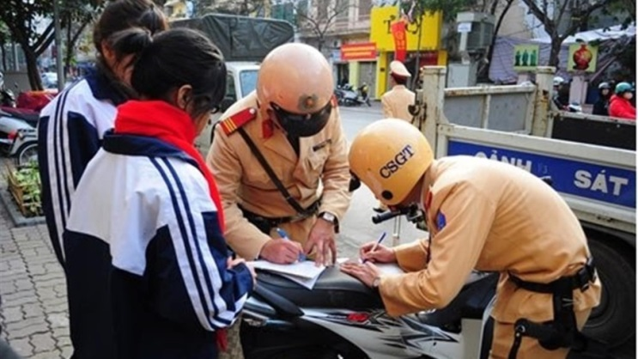
Your turn: Deductive or inductive?
Police’s argument:
You rode a 50+cc motorbike while you are under 16.
Therefore, you violated Vietnamese traffic law.
Police’s full argument:
_{1. According} to Vietnamese traffic law, 16 year-olds can only ride 50cc motorbikes. (missing general premise)
2. You rode a 50+cc motorbike while you are under 16. (specific premise)
3. Therefore, you violated Vietnamese traffic law. (conclusion)
→ Deductive argument
Notes:
https://luatvietnam.vn/hanh-chinh/bao-nhieu-tuoi-duoc-chay-xe-may-50cc-570-22523-article.html

Slide 24
Your turn: Deductive or inductive?
_{On-looker’s argument:}
1. The police stopped two teenagers on their way to school. (observation 1)
2. One teenager was wearing the red scarf for secondary school. (observation 2)
3. The police were writing something on a motorbike. (observation 3)
_{So} I guess the two teenagers were being fined for underage driving. (conclusion)
→ Inductive argument

Slide 25

Your turn: Deductive or inductive?
Task: Insert missing premise(s) if any, and decide if the argument below is deductive or inductive.
Doctor: Tim is having a fever, aching muscles, and a dry, persistent cough. Perhaps he is having the flu.

Slide 26
Your turn: Deductive or Inductive?
Doctor: Tim is having a fever, aching muscles, and a dry, persistent cough. Perhaps he is having the flu.
Perhaps he is having the flu. (conclusion)
Common flu symptoms: fever over 100.4 F (38ºC), aching muscles, chills and sweats, headache, dry, persistent cough, fatigue and weakness, nasal congestion, sore throat (pattern)
Tim is having a fever. (observation/specific premise 1)
Tim is having aching muscles. (observation/specific premise 2)
Tim is having a dry, persistent cough. (observation/specific premise 3)
→ Inductive argument

Slide 27

Your turn: Deductive or inductive?
Task: Insert missing premise(s) if any, and decide if the argument below is deductive or inductive.
_{Rằng tôi chút phận đàn bà}
Ghen tuông thì cũng người ta thường tình
(Hoạn Thư – Truyện Kiều)
I’m a woman.
So it’s normal when I’m jealous.

Slide 28
Your turn: Deductive or inductive?
Task: Insert missing premise(s) if any, and decide if the argument below is deductive or inductive.
1. All women are jealous by nature. (missing general premise)
2. I’m a woman. (specific premise)
3. So, it’s normal that I’m jealous. (conclusion)
(Hoạn Thư – Truyện Kiều)
→ Deductive argument

Slide 29
Deductive arguments’ claims
General premise
If the premises are true, the conclusion must be true.
The conclusion follows necessarily from the premises.
It is impossible for all the premises to be true and the conclusion false.
If you accept the premises, you must accept the conclusion.
Specific premise
Specific premise
Conclusion

Slide 30
Deduction indicators
certainly definitely
absolutely conclusively
It logically follows that
It is logical to conclude that
This logically implies that
This entails that

Slide 31
Inductive arguments’ claims
Generalization
(theory)
If the premises are true, the conclusion is probably true.
The conclusion follows probably from the premises.
It is unlikely for the premises to be true and the conclusion false.
The conclusion is probably true if the premises are true.
Conclusion
(hypothesis)
Pattern
Premise
(observation)
Premise
(observation)
Premise
(observation)

Slide 32
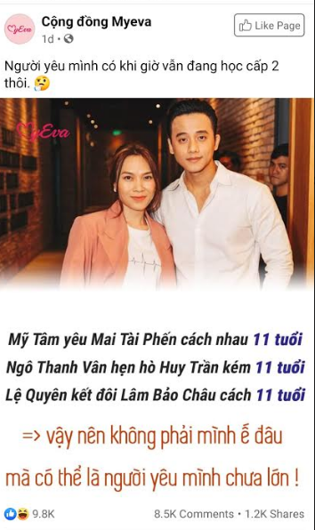
Sample inductive reasoning
P.1. Singer T’s boyfriend is 11 years younger than her.
P.2. Actress V’s date is 11 years younger than her.
P.3. Singer’s Q’s partner is 11 years younger than her.
C. So, it’s not true that we’re unmatched; it’s probable that our sweethearts are just kids now!

Slide 33
Induction indicators
probably likely
One would expect that
It is plausible to suppose that
It is reasonable to assume that
Chances are that
Odds are that

Slide 34
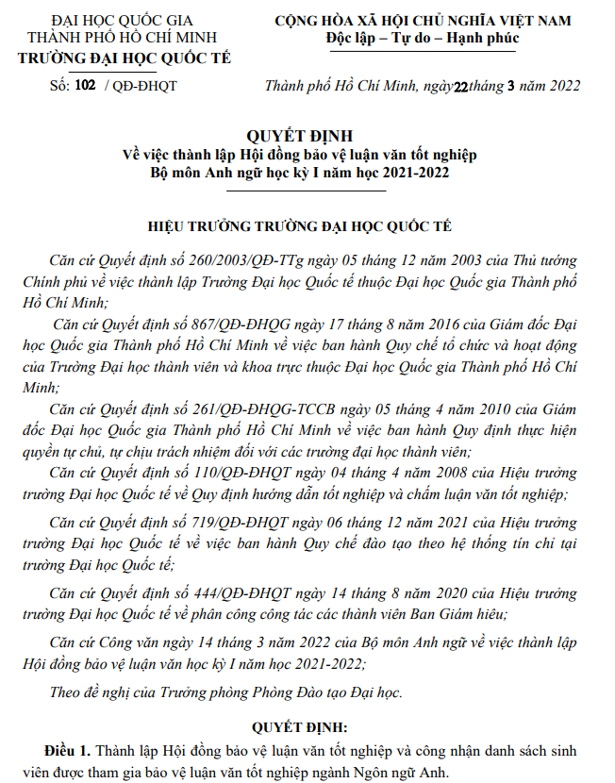
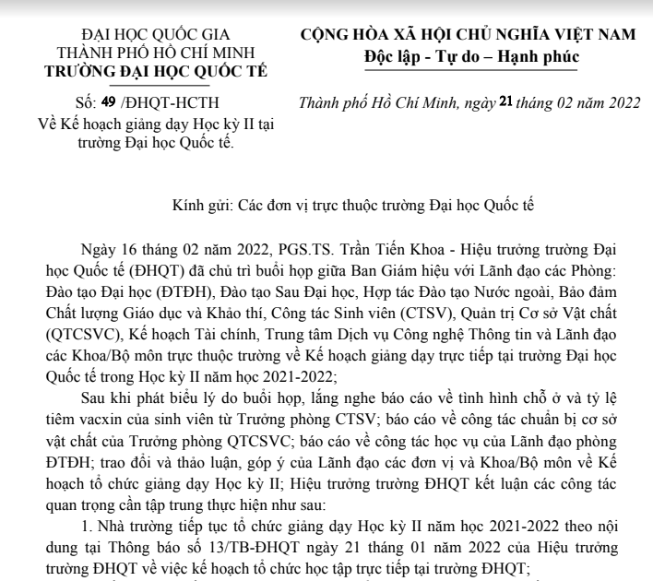
Application: Deductive or inductive?
Deductive
Inductive

Slide 35
COMMON PATTERNS OF DEDUCTIVE REASONING
1. Hypothetical syllogism
2. Categorical syllogism
3. Argument by elimination
4. Argument based on mathematics
5. Argument from definition
Notes:
Syllogism: three-line argument: tam đoạn luận

Slide 36
1. HYPOTHETICAL SYLLOGISM (chain argument)
If you miss the bus, you’ll be late for class.
If you’re late for class, you’ll miss the lesson.
So, if you miss the bus, you’ll miss the lesson.
Pattern: If A, then B.
If B, then C.
Therefore, if A then C.
Valid

Slide 37
1. HYPOTHETICAL SYLLOGISM (modus ponens – affirming the antecedent)
If you want to get a scholarship, you’ll have to study hard.
You certainly want to get the scholarship.
Therefore, you’ll have to study hard.
Pattern: If A, then B.
A.
Therefore, B
Valid
Notes:
Syllogism (tam đoạn luận): a three-line argument, including:
Major premise: tiền đề chính
Mior premise: Tiền đề phụ
Conclusion
A conditional sentence has two parts: antecedent (if clause) stands before the consequent (clause standing after)

Slide 38
1. HYPOTHETICAL SYLLOGISM (modus tollens – denying the consequent)
If you live in Paris, then you live in France.
You don’t live in France.
Therefore, you don’t live in Paris.
Pattern: If A, then B.
Not B.
Therefore, not A.
Valid

Slide 39
1. HYPOTHETICAL SYLLOGISM (denying the antecedent)
If Mr. Smith is President of the U.S., then he’s a famous person.
Mr. Smith is not President of the U.S.
Therefore, he’s not a famous person.
Pattern: If A, then B.
Not A.
Therefore, not B.
Invalid

Slide 40
1. HYPOTHETICAL SYLLOGISM (affirming the consequent)
If you live in Paris, then you live in France.
You live in France.
Therefore, you live in Paris.
Pattern: If A, then B.
B.
Therefore, A.
Invalid

Slide 41
Task: Sort them out.
If we’re in London, then we’re in England. We are not in England. So, we are not in London.
If we’re in Los Angeles, then we are in the United States. We are in the United States. So, we are in Los Angeles.
If we’re in the United States, then we are on Earth. We are in the United States. So, we are on Earth.
If we’re in Paris, then we are in France. If we’re in France, then we are in Europe. So, if we are in Paris, then we are in Europe.
If we’re in Houston, then we are in the United States. We are not in Houston. So, we are not in the United States.
Notes:
Check Key for Chapter 3 for the answers

Slide 42
Task: Sort them out.
6. If we’re in Shanghai, then we are in China. So, we are in China, because we are in Shanghai.
7. We are not in Mexico, because if we are in Mexico City, we are in Mexico, and we are not in Mexico City.
8. We are in India if we are in Calcutta. Since we’re in India, we are in Calcutta.
9. If we’re in Toronto, then we are in Canada. If we are in Canada, we are in North America. So, if we are in Toronto, then we are in North America.
10. We’re in Berlin, given that if we are in Berlin, then we are in Germany, and we are in Germany.
Notes:
Check Key for Chapter 3 for the answers
6. If we’re in Shanghai, then we are in China.
We are in Shanghai.
So, we are in China.
7. If we are in Mexico City, we are in Mexico
We are not in Mexico City.
Therefore, we are not in Mexico.
8. If we are in Calcutta, we are in India.
We are in India.
So we are in Calcutta.
9. If we’re in Toronto, then we are in Canada. If we are in Canada, we are in North America. So, if we are in Toronto, then we are in North America.
10. If we are in Berlin, then we are in Germany.
We are in Berlin.
So, we are in Germany.

Slide 43
2. CATEGORICAL SYLLOGISM
Example 1: With ‘All’
All Critical Thinking books contain deductive and inductive arguments.
All deductive and inductive arguments are patterns of logical reasoning.
So, all Critical Thinking books contain patterns of logical reasoning.
Example 2: With ‘Some’
Some students in our class are exchange students.
All exchange students are foreigners.
So, some students in our class are foreigners.

Slide 44
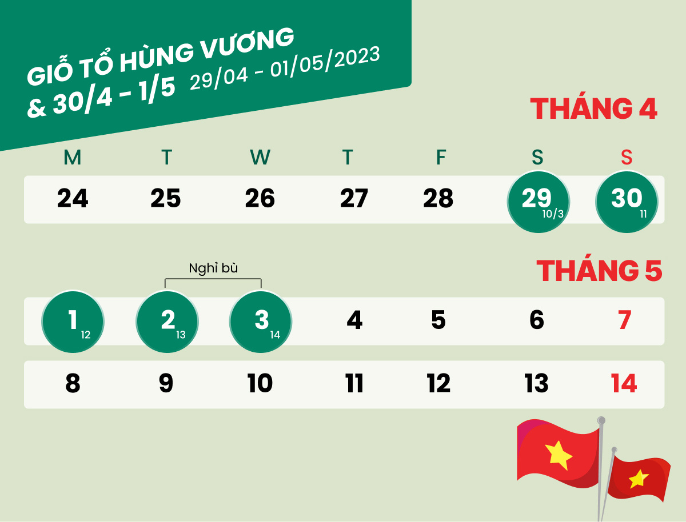
Task: Fill in the minor premise.
Premise 1: All holidays falling on weekends are made up for in the coming weekdays.
Premise 2: __________________________________________________________
Conclusion: It is logical to infer that there are two make-up holidays after April 30.
Notes:
There are two holidays falling on weekends on April 29 and April 30.

Slide 45
3. Argument by elimination
Example 1:
Either you are married or you are single by law.
You are not married.
Then you are single by law.
Example 2:
All arguments are either deductive or inductive.
Jack’s argument is not deductive.
Therefore, his argument is ______.

Slide 46
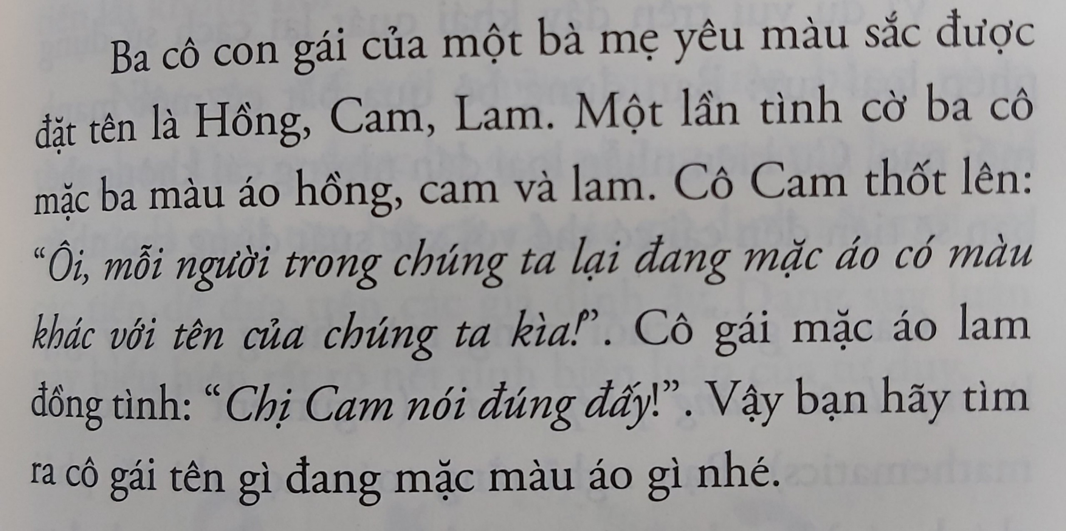
Task: Find the conclusion for this argument from elimination
Source: Tư duy biện luận – Nghĩ hay hơn hay nghĩ

Slide 47
Answer
Reasoning pattern: Deductive argument
Type of argument: Argument by elimination
Cam says each person wears a shirt with a different color from that person’s name (general premise)
Cam wears blue or pink. (sub conclusion 1)
The girl with the blue shirt agrees with Cam. (minor premise)
Cam can’t wear blue. (sub conclusion 2)
Cam wears pink. (conclusion 1)
Hồng wears blue. (conclusion 2)
Lam wears orange. (conclusion 3)
Therefore, it is logical to conclude that Cam wears pink, Hồng wears blue and Lam wears orange.
Notes:
. Đặng Duy Huy - BABAIU21409
2. Nguyễn Bá Hoàng - BABAIU21397
3. Đào Công Hào - BABAIU21391
4. Lê Thị Khánh Huyền - BABAIU21413
5. Lê Huỳnh Khánh Linh - BABAIU21432
6. Trần Phương Uyên - BABAIU21300
7. Mai Phương Ly - BABAIU21441
8. Trương Đăng Khoa - BABAIU21423

Slide 48
4. Argument based on Mathematics
Question:
The sun is 93 million miles from Earth, and light travels at a rate of 186,000 miles per second. How long does it take for light from the sun to reach the Earth?
The formula for calculating time is t(time) = distance/speed.
(general premise)
Sunlight travels at a rate of 186,000 miles per second (s).
The sun is more than 93 million miles away from Earth (d).
Therefore, it takes 500 seconds for light from the sun to reach the earth.
(specific premise)
(specific premise)
(conclusion)

Slide 49
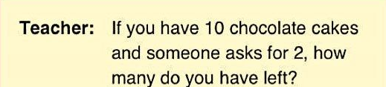
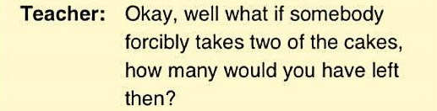
4. Argument based on Mathematics
1 + 1 = ?
1 + 1 = 2
(integer)
1 shoe + 1 shoe = 1 pair of shoes
The use of precise vocabulary and grammar is essential in arguments based on mathematics.

Slide 50
5. Argument from Definition
Example 1:
Mary is 13 years old. Therefore, she is a teenager.
Definition of a teenager: a person aged between 13 and 19 years
*Example 2:
Daisy is my daughter. Therefore, she is a female.
Definition of a daughter: a girl or woman in relation to her parents.
Question for example 2: Is this conclusion true?
Answer: It used to be true.
Notes:
Note: Arguments from generally accepted definitions are mostly valid and sound, not always. This is because definitions may change.
Example 2: Today, a daughter is not always a female when transgender is possible and accepted.

Slide 51
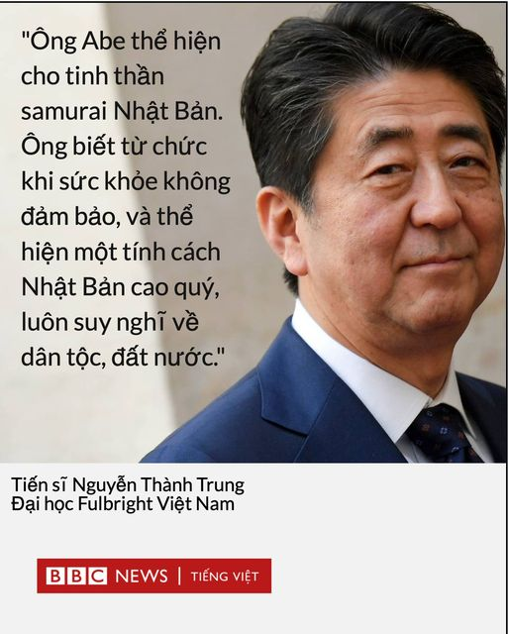
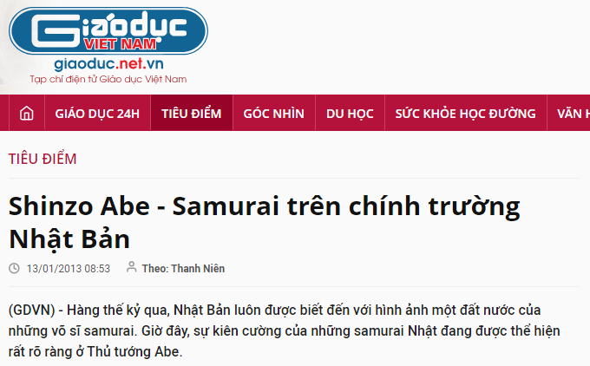
Argument from definition
Major premise: The ideal samurai was supposed to be a stoic warrior who followed an unwritten code of conduct, later formalized as Bushidō, which held bravery, honour, and personal loyalty above life itself; ritual suicide by disembowelment (seppuku) was institutionalized as a respected alternative to dishonour or defeat. (Britanica)
Minor premise: The late former Prime Minister Shinzo Abe was a brave warrior in Japanese political arena, resigned from office when having health problems, and showed the noble Japanese dedication to his country and people.
Conclusion: Therefore, the late former Prime Minister Shinzo Abe represents the samurai spirit of Japan.
Notes:
https://giaoduc.net.vn/tieu-diem/shinzo-abe-samurai-tren-chinh-truong-nhat-ban-post106178.gd
https://www.britannica.com/topic/samurai

Slide 52
Deductive validity
Valid deductive arguments: conclusion must follow from premises; in other words, it’s impossible that all premises are true but the conclusion is false.
Example 1:
If you want to get a scholarship, you’ll have to study hard.
You certainly want to get the scholarship.
Therefore, you’ll have to study hard.
Valid
Example 2:
If you want to get a scholarship, you’ll have to study hard.
You don’t study hard at all.
Therefore, you will get the scholarship.
Invalid

Slide 53
Deductive validity
Valid deductive arguments: may be sound or unsound
Example 1:
All International University students do their majors in English.
I’m an International University student.
Therefore, I do my major in English.
Valid and sound (true)
Example 2:
All International University students are aliens.
I’m an International University student.
Therefore, I’m an alien.
Valid but unsound (true)

Slide 54
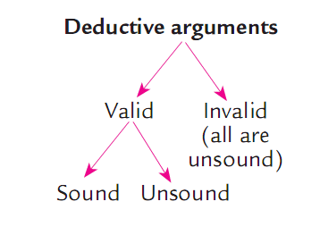
Generalization of deductive validity

Slide 55
Fun corner: Valid/Invalid - Sound/Unsound?
I skipped breakfast for a week to save $16 for my first date. I bought my girl 9 roses at $1.50/each. Then we went to the park and had two cans of diet coke at $2/each while enjoying our wonderful moment together. So, life is still wonderful with just $16 for a date! ☺ ☺ ☺
16 – 13.5 – (2 x 2) = -1.5
INVALID

Slide 56
COMMON PATTERNS OF INDUCTIVE REASONING
1. Inductive generalization
2. Predictive argument
3. Argument from authority
4. Causal argument
5. Statistical argument
6. Argument from analogy

Slide 57
1. INDUCTIVE GENERALIZATION
My boyfriend never gives me a flower on Valentine. All men are so unromantic!
Too hasty conclusion!
Notes:
The smaller sample we base our conclusion on, the weaker it is.

Slide 58
2. PREDICTIVE ARGUMENT
Every time I come home with the smell of beer, my wife gets angry! I’ve just drunk a lot of beer. So my wife will get angry.
Notes:
Predictive arguments like this are normally weak, because they are based on the assumption that things stay constant. In reality, things keep changing. For example, this time I go home getting drunk but having a lot of money, may be my wife will be happy, not angry like before ☺

Slide 59
3. ARGUMENT FROM AUTHORITY
There’s an Edusoft announcement that students will resume learning on campus on Thursday after the holiday.
So I have to book a flight back to HCMC on Wednesday night at the latest.
My girlfriend keeps warning me never to look at any girl in the street.
So I must keep my eyes only on her whenever we hang out.
Notes:
Authority means a person, an opinion, etc. which has power in certain contexts: I may be an authority in our class, your father is an authority at home…
If the authority is not reliable, the conclusion will be weak.

Slide 60
4. CAUSAL ARGUMENT
I can’t call him on my mobile phone. I’m sure the network is down.
weak
I can’t call him on my mobile phone. The network is probably down.
strong
Notes:
There are many reasons you can’t call someone: he may block you, he is out of the reception area… To make your conclusion stronger, avoid absolute words like certainly,. obviously…

Slide 61
5. Statistical argument
100% of IU students have to learn Critical Thinking while this subject is optional at University X. Therefore, IU has more learners of critical thinking than University X.
Notes:
The percentage does not mean much but the real number is more important. In this example, if IU’s student population is 3000 but University X has 30.000, 60% of students in University X is 18.000!

Slide 62
6. ARGUMENT FROM ANALOGY
A is an IU student and she’s confident and dynamic.
B is an IU student and he’s confident and dynamic.
C is an IU student, so I’m sure she’s confident and dynamic.
Weak
A is an IU student and she’s confident and dynamic.
B is an IU student and he’s confident and dynamic.
C is an IU student, so it’s likely that she’s confident and dynamic.
Stronger
Notes:
This type of inductive argument is a generalized pattern. Do not jump to a firm conclusion if we are not sure all conditions are alike and the sample is large enough.

Slide 63
Inductive strengths
Strong inductive arguments: The conclusion is probably true if the premises are true.
Weak inductive arguments: Premises, even if they are assumed to be true, do not make the conclusion probable.
Example 1:
Kim told me her family is not affordable for her college tuition. She has been studying so hard in the last year of high school. Kim is probably trying to gain a college scholarship.
Strong
Example 2:
About 5% of IU students are international students now. Kim is an IU student. So she is probably an international student.
Weak

Slide 64
Inductive strengths (cont)
Strong and weak inductive arguments come in degrees:
Example 1:
There is a 90% chance that Tom will pass the exam.
Therefore, he will probably pass the exam.
Example 2:
There is a 60% chance that Tom will pass the exam.
Therefore, he will probably pass the exam.
Example 3:
There is a 40% chance that Tom will pass the exam.
Therefore, he will probably pass the exam.

Slide 65
Inductive strengths (con’t)
Strong inductive arguments may be cogent or uncogent:
Example 1:
It’s the rainy season and it has been raining for the last 3 days.
Therefore, it is probably going to rain today.
Strong and cogent (convincing)
Example 2:
Rainy days generally result in dry weather and it is raining now.
Therefore, we’ll probably have dry weather today.
Strong but uncogent (at least one premise is false)

Slide 66
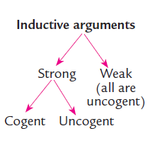
Generalization of inductive strength

Slide 67
PRACTICE
DEDUCTIVE OR INDUCTIVE?
valid/invalid?
sound/unsound?
weak or strong?
cogent/uncogent?
Identify the premise(s) and conclusion.
Identify the type of argument.
Evaluate each argument.

Slide 68
Argument 1
Argument 2
A sample of fifty motorists who were stopped in accidents on the freeway revealed that one in four drivers were either uninsured, intoxicated, or both. Thus, if you get involved in an accident on the freeway, there is a 25% chance the other motorists are drunk or uninsured.
The Law of the Sea treaty states that any vessel beyond a 12 mile limit is in international waters. The treaty also states that any vessel in international waters cannot be legally stopped or boarded. Therefore, when the U.S. Coast Guard stops boats coming from Cuba or Haiti more than 12 miles from the U.S. coast, it is violating the Law of the Sea.

Slide 69
Deductive or inductive reasoning?
A sample of fifty motorists who caused accidents on the freeway revealed that one in four drivers were either uninsured or drunk, or both. (observation)
Thus, if you get involved in an accident with motorcycles on the freeway, there is a 25% chance the motorists are uninsured, drunk, or both. (Conclusion)
→ inductive argument from generalization
one in four = a 25% chance → strong
a sample of 50 motorists: too small compared with all motorists on freeways
Weak argument

Slide 70
Deductive or inductive reasoning?
The Law of the Sea Treaty states that any vessel beyond a 12 mile limit is in international waters. (General premise)
The Treaty also states that any vessel in international waters cannot be legally stopped or boarded. (General premise)
The U.S. Coast Guard stops boats coming from Cuba or Haiti more than 12 miles from the U.S. coast. (Specific premise)
Therefore, the U.S. Coast Guard is violating the Law of the Sea. (Conclusion)
→ deductive argument: valid
If 1 + 2 are true → sound
If either 1 or 2 is untrue, or both 1 + 2 are untrue → unsound

Slide 71
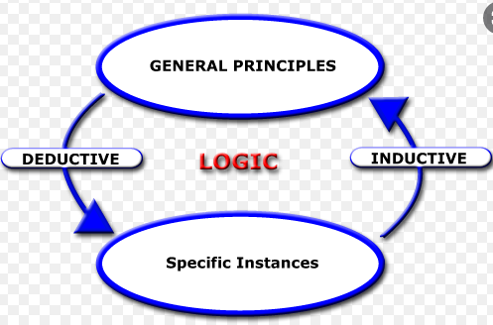
INDUCTIVE PATTERNS
Review of Chapter 3
DEDUCTIVE PATTERNS
1. Hypothetical syllogism
2. Categorical syllogism
3. Argument from definition
4. Argument from elimination
5. Argument based on mathematics
1. Inductive generalization
2. Predictive argument
3. Argument from authority
4. Causal argument
5. Statistical argument
6. Argument from analogy

Slide 72
Assignment for Chapter 3
Task: Make FIVE arguments from the given clues.
Indicate:
Premises (major/minor premises or observations)
Conclusion:
Assumption:
Type of argument: (out of 5 deductive and 6 inductive patterns)
Link to submit:
https://forms.gle/dvAu1ZcD6uN7h9gV6
Notes:
Instructions: Delete all the lesson slides, keep only the assignment slides and submit your file to the link.

Slide 73
Group:
Full name:
Full name:
….

Slide 74
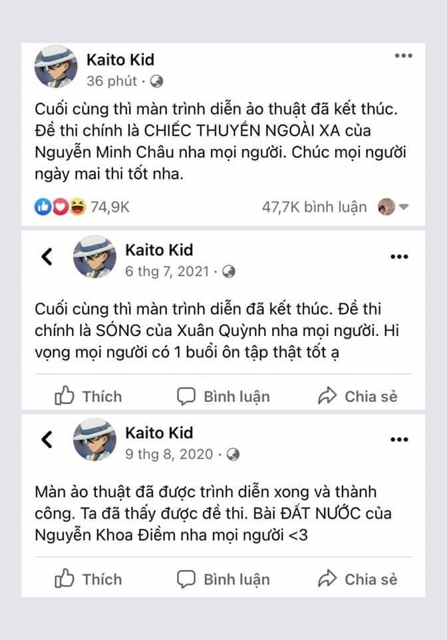
Input for your arguments
Trước đó, ngay sau khi kết thúc thời gian thi môn Văn, mạng xã hội hoang mang trước thông tin một nhóm diễn đàn liên quan đến học đường với 2,3 triệu thành viên đã tiết lộ "2k5 biết nương tựa vào ai rồi đấy". Kèm theo đó là hình ảnh một tài khoản khá nổi tiếng trên mạng xã hội tên Kaito Kid đã công bố dự doán đúng đề thi môn Văn tốt nghiệp THPT năm 2022. Không chỉ thế, tại khoản này còn đoán đúng cả môn Văn 3 năm của kỳ thi.
Kaito Kid: "Tất cả tác phẩm mình đăng chỉ là do dự đoán của mình. Và việc đoán chính xác 3 tác phẩm liên tiếp có lẽ do mình may mắn. Như hôm qua, mình cũng phân vân sẽ chọn "Ai đã đặt tên cho dòng sông" hay "Chiếc thuyền ngoài xa" để đăng lên phỏng đoán. Nhưng vì "Ai đã đặt tên cho dòng sông" đã ra đề minh họa của năm trước rồi nên mình chọn "Chiếc thuyền ngoài xa". Hi vọng mọi người đừng đẩy sự việc đi quá xa, sẽ ảnh hưởng đến mình".
Premise + type:
Conclusion:
Argument pattern:
Notes:
https://danviet.vn/nghi-van-lo-de-thi-mon-van-tot-nghiep-thpt-nam-2022-bat-ngo-khi-noi-dung-ca-3-nam-20220707134349575.htm?fbclid=IwAR3-tSCty_NKTDRWPae0OfgPoshEcIxvv4fJWkMYCer6u4FRJzShPWHTe0E
https://danviet.vn/gay-hoang-mang-lo-de-thi-van-tot-nghiep-thpt-nam-2022-tai-khoan-trom-de-la-mot-sinh-vien-20220707141215672.htm

Slide 75
Sample argument 1
P1. Kaito Kid made a correct prediction for the Literature test topic in 2020. (observation)
P2. Kaito Kid made a correct prediction for the Literature test topic in 20201. (observation)
P3. Kaito Kid made a correct prediction for the Literature test topic in 20222. (observation)
Conclusion: So, 2k5 students know who you will rely on.
Assumption: Kaito Kid always makes good predictions.
Type of argument: predictive argument
Premise + type:
Conclusion:
Assumption:
Type of argument:
Notes:
https://danviet.vn/nghi-van-lo-de-thi-mon-van-tot-nghiep-thpt-nam-2022-bat-ngo-khi-noi-dung-ca-3-nam-20220707134349575.htm?fbclid=IwAR3-tSCty_NKTDRWPae0OfgPoshEcIxvv4fJWkMYCer6u4FRJzShPWHTe0E
https://danviet.vn/gay-hoang-mang-lo-de-thi-van-tot-nghiep-thpt-nam-2022-tai-khoan-trom-de-la-mot-sinh-vien-20220707141215672.htm

Slide 76
Sample argument 2
Nettizens:
P1. Kaito Kid made a correct prediction for the Literature test topic in 2020. (observation)
P2. Kaito Kid made a correct prediction for the Literature test topic in 2021. (observation)
P3. Kaito Kid made a correct prediction for the Literature test topic in 2022. (observation)
Conclusion: So, Kaito Kid must have known the topics for the Literature tests in advance.
Assumption: The test papers were leaked for three consecutive years.
Type of argument: causal argument
Premise + type:
Conclusion:
Assumption:
Type of argument:
Notes:
https://danviet.vn/nghi-van-lo-de-thi-mon-van-tot-nghiep-thpt-nam-2022-bat-ngo-khi-noi-dung-ca-3-nam-20220707134349575.htm?fbclid=IwAR3-tSCty_NKTDRWPae0OfgPoshEcIxvv4fJWkMYCer6u4FRJzShPWHTe0E
https://danviet.vn/gay-hoang-mang-lo-de-thi-van-tot-nghiep-thpt-nam-2022-tai-khoan-trom-de-la-mot-sinh-vien-20220707141215672.htm

Slide 77
Sample argument 3
Kaito Kid:
P1. I made a correct prediction for the Literature test topic in 2020. (observation)
P2. I made a correct prediction for the Literature test topic in 20201. (observation)
P3. I made a correct prediction for the Literature test topic in 20222. (observation)
Conclusion: So, it is probable that I have been lucky.
Assumption: There was no leaking of test papers.
Type of argument: causal argument
Notes:
https://danviet.vn/nghi-van-lo-de-thi-mon-van-tot-nghiep-thpt-nam-2022-bat-ngo-khi-noi-dung-ca-3-nam-20220707134349575.htm?fbclid=IwAR3-tSCty_NKTDRWPae0OfgPoshEcIxvv4fJWkMYCer6u4FRJzShPWHTe0E
https://danviet.vn/gay-hoang-mang-lo-de-thi-van-tot-nghiep-thpt-nam-2022-tai-khoan-trom-de-la-mot-sinh-vien-20220707141215672.htm

Slide 78
Sample argument 4
Kaito Kid:
P1. I considered between “Ai đã đặt tên cho dòng sông” and “Chiếc thuyền ngoài xa”. (observation)
P2 . “Ai đã đặt tên cho dòng sông” was in the test last year. (observation)
Conclusion: So, I decided on “Chiếc thuyền ngoài xa” for this year’s test.
Assumption: Test questions are not reused in a short time.
Type of argument: predictive argument from elimination
Notes:
https://danviet.vn/nghi-van-lo-de-thi-mon-van-tot-nghiep-thpt-nam-2022-bat-ngo-khi-noi-dung-ca-3-nam-20220707134349575.htm?fbclid=IwAR3-tSCty_NKTDRWPae0OfgPoshEcIxvv4fJWkMYCer6u4FRJzShPWHTe0E
https://danviet.vn/gay-hoang-mang-lo-de-thi-van-tot-nghiep-thpt-nam-2022-tai-khoan-trom-de-la-mot-sinh-vien-20220707141215672.htm

Slide 79
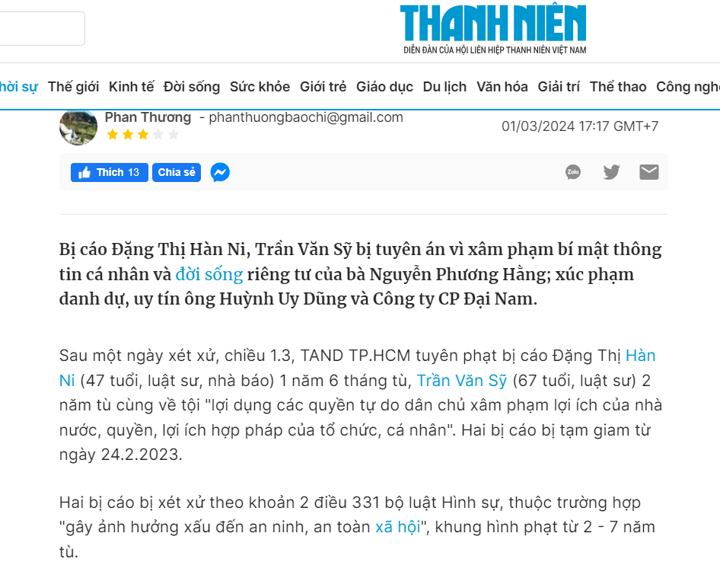
Task 1: Make an argument based on the clue
Premise + type:
Conclusion:
Assumption:
Type of argument:

Slide 80
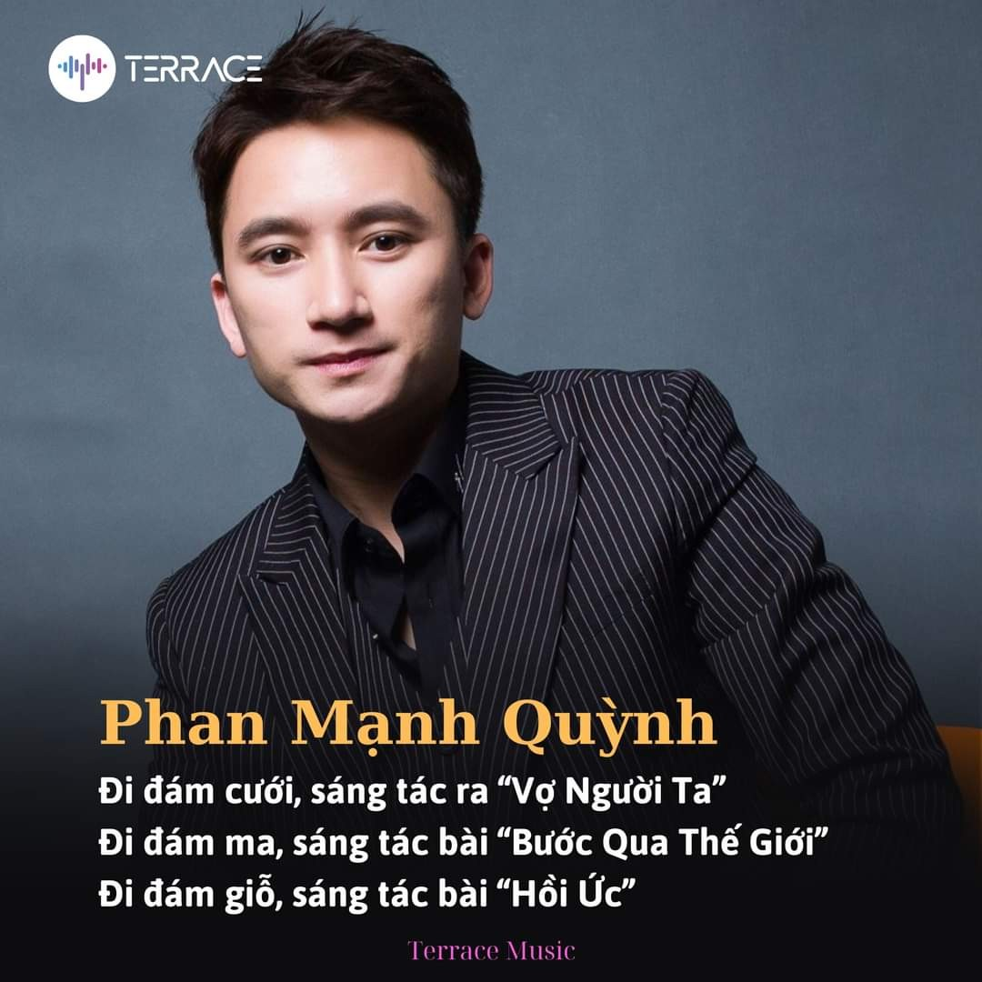
Task 2: Make an argument based on the clue
Premise + type:
Conclusion:
Assumption:
Type of argument:

Slide 81
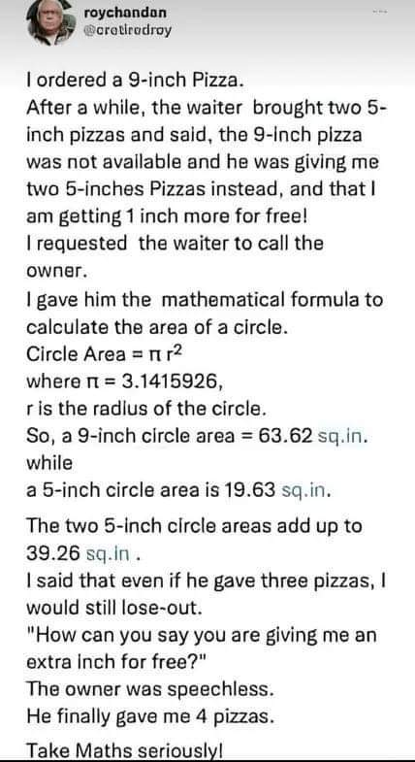
Task 3: Make an argument based on the clue
Premise + type:
Conclusion:
Assumption:
Type of argument:

Slide 82
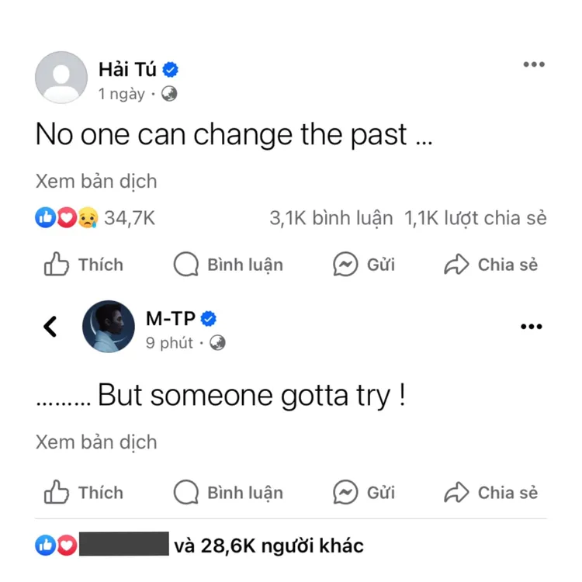
Task 4: Make an argument based on the clue
Premise + type:
Conclusion:
Assumption:
Type of argument

Slide 83
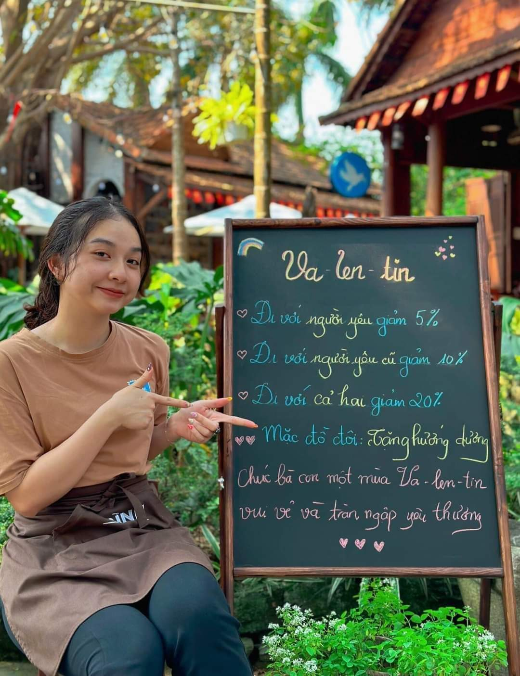
Task 5: Make an argument based on the clue
Premise + type:
Conclusion:
Assumption:
Type of argument:
Notes:
https://plo.vn/mo-xe-vu-du-doan-dung-de-thi-van-bi-de-nghi-xem-xet-xu-phat-hanh-chinh-post689380.html

Slide 84
Task 6: Make an argument based on YOUR clue
Premise + type:
Conclusion:
Assumption:
Type of argument:

Slide 85

85

